Slide 1

(Almost) Fence-less Persist Ordering
Sara Mahdizadeh Shahri, Armin Vakil, Aasheesh Kolli
MICRO 2020

Slide 2




Persistent Memories (PM)
Performance
Density
Non-volatility
Byte-addressability

Slide 3




Failure Atomicity
Alice
Bob
20$
50$
20$
30$
40$
PM
Updates need to be visible atomically in PM

Slide 4
Failure Atomicity (cont.)
Alice
Bob
20$
Failure
50$
20$
30$
PM
Money is lost!
How to guarantee failure atomicity?

Slide 5
Failure Atomicity by Undo Logging
- Undo Logging is a common technique to achieve Failure Atomicity
Create and Persist Log
Fence
Update Data
Fence
Persist Data
Fence
Commit
How to provide the required ordering primitives more efficiently?

Slide 6
Contributions
- x86 memory persistency model
- Inefficient non-temporal temporal ordering
- Enforce unnecessary persist orderings
- Themis
- Provide this order without using fence
- 1.45x speedup over x86 memory persistency model

Slide 7
Outline
- Background
- x86 Memory Persistency Model
- Themis
- Evaluation

Slide 8



Memory System Architecture
Failure
core
core
D$
D$
Recovery
L2$+LLC
DRAM
PM

Slide 9
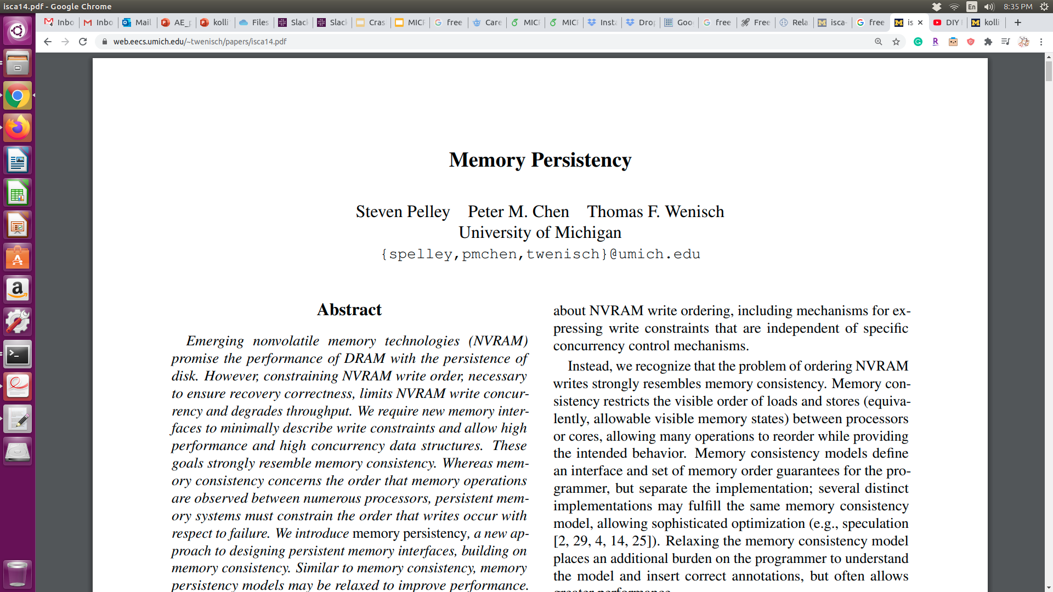
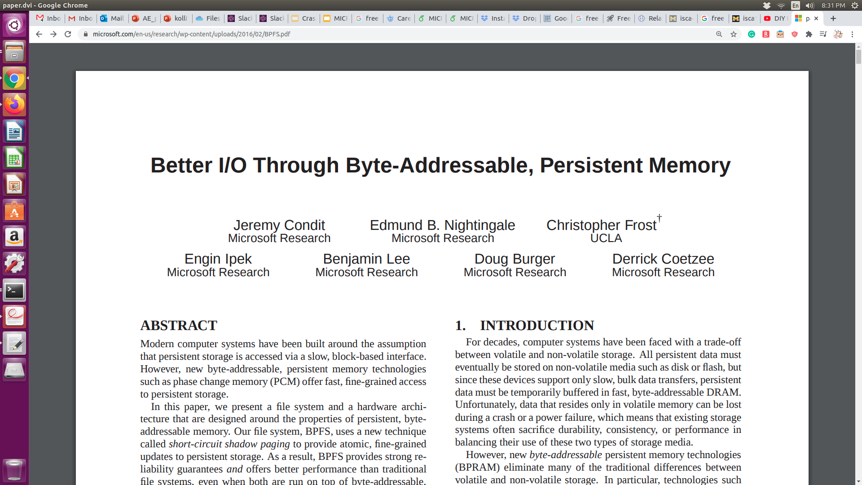
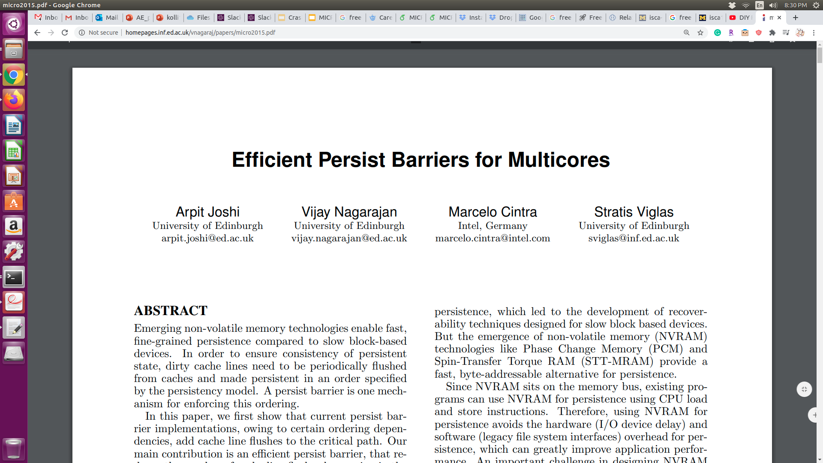
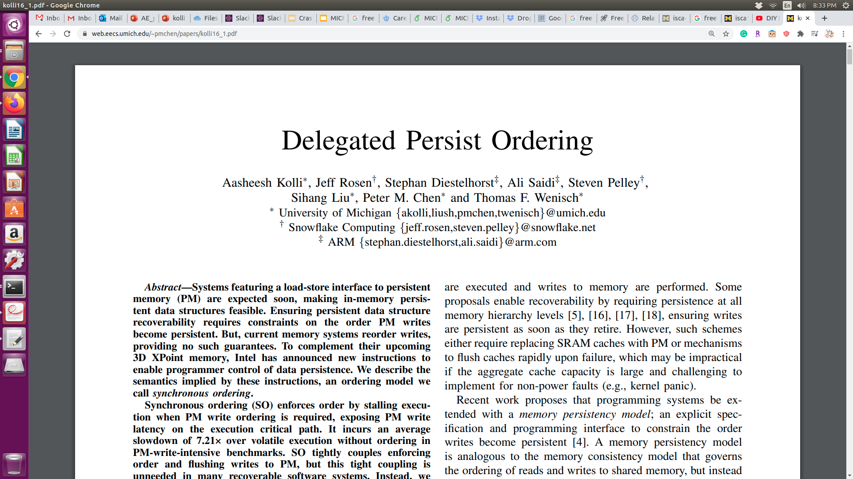
Memory Persistency Model
Constrains the order of writes to PM
x86 Memory Persistency Model

Slide 10
x86 Memory Persistency Model
Non-temporal Path
movnt log
sfence
core
core
log
data
WCB
D$
D$
WCB
WriteCombining
Buffer
Temporal Path
L2$+LLC
store data clflushopt/clwb
sfence
DRAM
PM
Temporal and Non-temporal path are not in sync

Slide 11
Ordering Across Paths
movnt log
store data
persist data
core
core
log
data
sfence
WCB
D$
D$
WCB
L2$+LLC
DRAM
PM
How costly is this ordering primitive?

Slide 12
Opportunity
2.68x
1.67x
Better
1.67x speedup by removing the sfence instruction

Slide 13

Ordering Across Paths (cont.)
core
core
log
movnt log
store data
persist data
data
sfence
WCB
D$
D$
WCB
WriteCombining
Buffer
L2$+LLC
DRAM
PM
Can we persist log before data without an sfence?

Slide 14







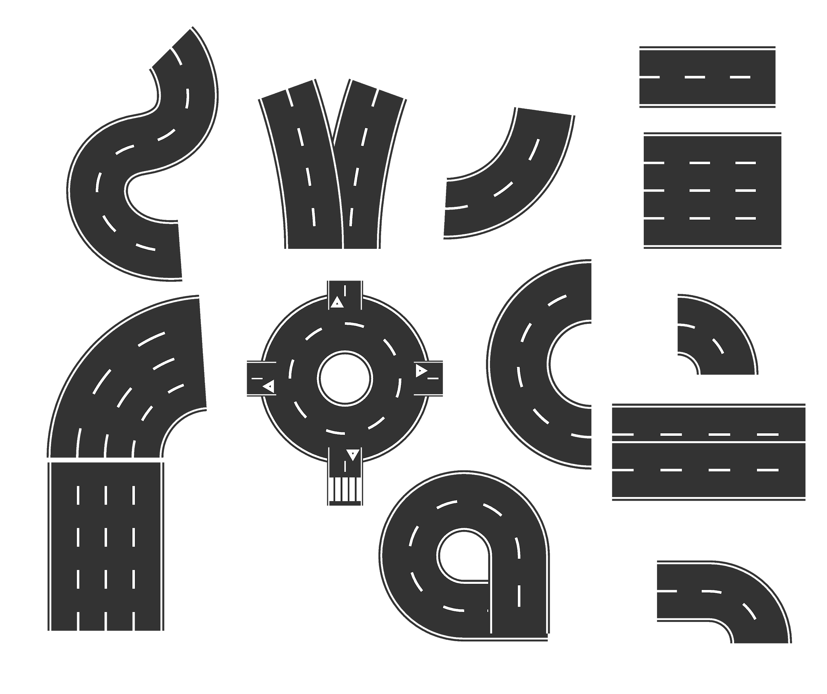
Analogy
Option #1
Home
Alice
Alice: I am home
Bob
Total time = Alice’s trip + Bob’s trip

Slide 15
Analogy
Option #2
Home
Alice
Bob
Alice: I am home
Total time = Bob’s trip

Slide 16

Analogy
Option #2 (cont.)
Home
Alice
Bob
Alice: Flat tire! Wait up!

Slide 17
Analogy Summary
Option # 1
Option # 2
Order
Serialize
Simultaneous
Speed
Slow
Fast
Persistency
Model
x86
Themis

Slide 18
Ordering Between Paths (Revisit)
core
core
log
movnt log
store data
persist data
data
sfence
WCB
D$
D$
WCB
WriteCombining
Buffer
L2$+LLC
DRAM
PM
Themis guarantees this order is always preserved

Slide 19
Themis
A light-weight x86 extension to provide efficient ordering semantics
Persistent non-temporal updates reach PM before any subsequent temporal stores without any intervening fence

Slide 20
Themis Architecture
core
core
WCB
D$
D$
WriteCombining
Buffer
WCB
WBB
WriteBack Buffer
WBB
L2$+LLC
DRAM
PM
Themis allows communication between temporal path(WBB) and non-temporal path(WCB)

Slide 21
Enforcing order in Themis
C
+ current WCB’s tail value
(wcb-tail)
tail
D$
WCB
wcb-tail
WBB
0.75KB overhead
head’
head
head’
wcb-tail
>=
Persistent block can be drained to L2 only when all its prior non-temporal requests are persisted

Slide 22

Themis in Action
C
Common Case
movnt log
store data
persist data
log
data,3
D$
WCB
CLWB
head=
tail=3
3
WBB
tail=2
3
1
head=1
A
3
3
>=
Data can be evicted from L1 as all its prior non-temporal requests that have been in WCB are persisted

Slide 23
Themis in Action
C
Uncommon Case
movnt log
store data
persist data
D$
WCB
data,3
CLWB
tail=3
2
log
WBB
1
head=2
2
head=1
A
2
3
>=
Data eviction is delayed untill all prior non-temporal requests are persisted

Slide 24
Experimental Setup
Gem5 Full-System - details in paper
Benchmarks
Simple Data Structures: Concurrent queue, Hashmap, Linked-list, Persistent cache, SPS. Tree-based Data Structures: C-Tree, Red-Black Tree. TATP and TPCC
Configs
x86 memory persistency model (baseline)
Themis
Ideal

Slide 25
Speedup
1.87x
Better
1.45x
Ordering is preserved without any significant performance loss

Slide 26
Sensitivity Analysis: Transaction Size
Better
Themis improvements are higher with larger transactions

Slide 27
Conclusion
- x86 provides two paths to PM
- Expensive fence instructions to order across paths
- Themis
- Implicit ordering guarantees without using an intervening fence instruction
- 1.45x speedup over x86 memory persistency model

Slide 28
Thank you!
This presentation and recording belong to the authors. No distribution is allowed without the authors' permission

